Slide 1
Modeling Orbital Edge Processing in a Contested Environment
Student Biweekly Progress Presentation to Advisor
Carlo Antonio Nino
10/03/2026
Satellite systems rely on ground communications for processing and decision support. The Praxis compares a ground-centric path with bounded orbital edge processing under matched degraded-link conditions.
The working method is discrete-event simulation (DES). The Excel v9 prototype now aligns AI/ML telemetry, communications and environmental records within a common time window.
The Chapter 2 first draft was sent to Dr. Hao on 27 September. Advisor feedback, reference allocation, MATLAB/SimEvents implementation and validation remain open.
1 of 5

Slide 2
Response to Advisor Feedback from previous meeting(s)
Develop Chapter 2 Literature Review and send a first draft for advisor review. [19 Sep 2026]
First draft sent to Dr. Hao on 27 Sep 2026. The red sections still need development and formatting; advisor feedback remains pending. [27 Sep 2026]
Fuse multiple data sources: normalize common variables, record rejections, and extract useful information from the initial Excel DES. [19 Sep 2026]
Individual Excel v9 data-fit trials led to a simultaneous OPS-SAT ACE hybrid. AI/ML, communications and environmental inputs align on 28 Jan 2022, 17:42–17:55 UTC. This establishes a common input window, not a validated causal result. [27–28 Sep 2026]
Establish a controlled Praxis repository, develop the first hand-drawn OV-1, and plan the MATLAB/SimEvents scale-up. [19 Sep 2026]
The Green Shared Praxis archive is accessible to Dr. Hao.
The non-AI OV-1 now has (modifiable) explanatory wording.
MATLAB/SimEvents Baseline #2 is defined as the next implementation path; a completed scaled run is still pending. [27–28 Sep 2026]
2 of 5
Notes:
Advisor quotations: ResearchReport -- Carlo Nino-Sep 06, 2026.pdf, items 3 and Additional Comments.
Red is Dr Hao. Yellow:
My answers in black below it.
FINAL SUBMISSION, SLIDE 2
This Praxis develops a simulation-based systems engineering framework to evaluate autonomous satellite decision support under degraded communications.
The study compares ground-centric routing against an orbital edge-processing path using public orbital data and space-weather indices.
The modeled decisions include onboard filtering, alert prioritization, downlink prioritization, resource allocation, and safe-response recommendations for ground operator review.
The framework evaluates onboard artificial intelligence and machine learning for predictive threat assessment and response.
The model assesses decision latency, operator workload, cognitive burden, and resource utilization through simulation.
The work produces a public-domain feasibility study and a preliminary Concept of Operations.
Validation compares simulated outputs against public benchmarks, theoretical delay calculations, repeated runs, and sensitivity analysis.
The research will not use classified data, develop new algorithms, or build physical hardware.
Scope of Work
SPEAKER NOTES
Modeling Autonomous Satellite Decision-Making in Contested Environments.
can an orbital edge-processing layer provide useful information to the operator faster?
The model focuses on bounded functions such as filtering, prioritizing, routing, allocating resources, and presenting recommendations.
The goal is to measure whether this architecture reduces latency, preserves communications availability, and reduces operator workload using only public, public, non-restricted data.”
FINAL SUBMISSION, SLIDE 6
Thesis Statement | This praxis will deliver a simulation-based systems engineering model demonstrating a bounded onboard decision-making framework under degraded communications.
Research Product | Simulation-Based Evaluation Framework
Format | Python/MATLAB/Simulink Model
Deliverable Usage | Systems engineers will use the framework during early architecture trades for onboard processing under degraded communications.
Tie back to PS | The framework will address decision latency by comparing ground-centric routing with bounded onboard decision support under the same scenarios.
New Contributions | This work will contribute a public, repeatable method for evaluating orbital edge-processing performance without classified data or new algorithms.
Scope | The framework will apply to autonomous systems that operate with degraded communications and constrained human oversight.
Main methodology | Discrete-Event Simulation
Inputs | Threat Type (Categorical), Threat Proximity (km), Communication Link Status (Boolean), Satellite Resource Availability (%), AI Confidence Score (%)
Outputs | Response Latency (seconds), Mission Success Probability (%), Resource Consumption (%), Correct Action Taken (Boolean)
FINAL SUBMISSION
Methodology
Methodology | Discrete-Event Simulation
Inputs | The Disruption Event Type (categorical), event start times (s), event duration (min), communication lag, ground station availability (Boolean), satellite visibility window (min), bandwidth capacity (Mbps), data volume (MB), packet loss rate (%), edge processing times, AI confidence score (%), satellite resource availability (%) | NA
Outputs | Response latency, OODA Loop decision cycle times, path availability (%), dropped messages (count), recovery time, operator workflow reduction comparison (%), correct action selection (%). | NA
Methodology 1 — Discrete-Event Simulation
Method:
“My first methodology is discrete-event simulation. It follows specific events in order—such as a request arriving, the ground-station path failing, the edge cloud processing the request, and a response reaching the operator.”
Inputs:
“The inputs include the disruption type, when it starts, how long it lasts, communication delay, processing time, and available resources.”
Outputs:
“The outputs include response latency, OODA-loop time, path availability, dropped messages, recovery time, workload reduction, and what % of the time the correct response was selected.”
Purpose:
“This method shows what happens during each individual disruption and compares the ground-centric path with the edge-enabled path.”

Slide 3
Progress Since Last Meeting
The public-data work moved from individual fit trials to a simultaneous Excel v9 baseline. OPS-SAT AI/ML telemetry, SatNOGS OPS-SAT communications observations and NASA OMNI environmental context share a bounded time window. This is the VENN diagram [27–28 Sep 2026]
The ground-centric versus bounded-edge comparison remains the controlled DES experiment. MATLAB/SimEvents Baseline #2 will reproduce the Excel logic before scaling run count and dataset size. [27 Sep 2026]
LITERATURE SNAPSHOT — methodological examples retained from the 19 Sep register
Author / year | Registered work — short title | Method / relevance recorded
Browne (2024) | EV charging: arrivals, utilization and wait times | DES / Monte Carlo; queueing and congestion
Littlefield (2017) | Reliability of highly parallel systems | DES; failures, redundancy and reliability
Shanbhag (2021) | Overcommitment on cloud-computing workloads | DES; finite compute resources and overload
Newell (2023) | Spare-part quantities and obsolescence cycles | DES; failures, repair and operational availability
Devineni (2023) | IT service incident resolution times | DES / Monte Carlo; waiting and resolution time
3 of 5
Notes:
SOURCE: GWU_Praxis_AIS_Master_Register_2026-09-13_Updated(1).xlsx
Selected citation titles are shortened on the slide; full metadata are below Dr Hao. This is for presentation only. I have the rest.
Dylan Browne (2024). Electric Vehicle Charge Station Expansion Analysis for EV Owners in Maryland: Stochastic Model Utilizing Monte Carlo Simulation Methodology to Determine Arrival Rates, Utilization and Wait Times of Electric Vehicles at Charge Station Infrastructure. GWU D.Eng. Praxis. George Washington University.
https://scholarspace.library.gwu.edu/etd/1v53jx95k
Recorded method: Discrete-event simulation; Monte Carlo; queueing
Recorded role: Potential template for MATLAB/DES experiments on processing queues, link bottlenecks, and latency distributions.
Scott Littlefield (2017). Application of Discrete Event Simulation to Modeling Reliability of Highly Parallel Systems with Common Cause Failures. GWU D.Eng. Praxis. George Washington University.
https://scholarspace.library.gwu.edu/downloads/x059c743t?disposition=inline&locale=en
Recorded method: Discrete-event simulation; reliability; sensitivity analysis
Recorded role: Use for degraded/disrupted architecture scenarios, common-mode failures, redundancy, and sensitivity analysis.
Ravi M. Shanbhag (2021). Implications of Overcommitment on Cloud Computing Workloads. GWU D.Eng. Praxis. George Washington University.
https://scholarspace.library.gwu.edu/concern/gw_etds/bk128b72k
Recorded method: Generative discrete-event simulation; cloud-resource overcommitment
Recorded role: High-value DES precedent for onboard compute queues, utilization limits, congestion, and overload thresholds.
Paul A. Newell Jr. (2023). Reducing System Lifetime Spare Part Quantities Using Obsolescence Cycles: A Discrete Event Simulation. GWU D.Eng. Praxis. George Washington University.
https://search.proquest.com/openview/88a43e1ad35e4f012b3bb98fb476f41b/1?cbl=18750&diss=y&pq-origsite=gscholar
Recorded method: Discrete-event simulation; reliability / repair / inventory / availability modeling
Recorded role: High-value template for availability experiments comparing distributed compute redundancy and degraded ground/space processing.
Kishan Ram Devineni (2023). Improving IT Service Incident Ticket Resolution Times using Lean and Agile Methodologies. GWU D.Eng. Praxis. George Washington University.
https://scholarspace.library.gwu.edu/concern/gw_etds/2j62s577p
Recorded method: Arena discrete-event simulation; Monte Carlo; process redesign
Recorded role: Useful for causal decomposition of end-to-end latency into queues, processing resources, and human workflow effects.

Slide 4
Issues Encountered and Setbacks
Chapter 2 in first draft awaiting advisor feedback.
The red sections need further development and formatting; citation allocation across the outline remains open. [27 Sep 2026]
A shared timestamp doesn’t by itself establish a causal link among the AI/ML, communications and environmental records.
Using NOAA to establish type/nature of the natural disruption. A qualifier.
Record source cadence, field acceptance/rejection and observed versus derived variables before simulation. [28 Sep 2026]
Environmental data provide scenario context, not measured network latency or loss. SatNOGS telemetry is not a substitute for direct link-performance measurements; architecture comparisons will use matched, explicitly bounded assumptions. [28 Sep 2026]
The Excel v9 ACE hybrid is a data-fit/prototype baseline.
MATLAB/SimEvents repeated runs, sensitivity analysis and validation evidence pending following successful coding. [28 Sep 2026]
4 of 5
Notes:
Open items, not severity escalation. The submitted hypotheses are preserved verbatim on appendix slide 9 and in its notes. Current scope and metric choices come from the user’s September clarification. Evidence status comes from the v05 research-source register.
FINAL SUBMISSION, SLIDE 8
(A) Deliverable | (B) Format | C) WC
Hypothesis 1 | Discrete-event simulation will model autonomous decision latency within 15% of public benchmark ranges. | 13
Independent Variables | AI algorithm processing time (ms), Sensor data ingestion rate (kbps), Number of simulated threats (integer) | NA
Dependent Variable | Modeled response latency (seconds) | NA
Testable | The model's latency output will be compared against latency figures from unclassified literature and theoretical calculations for validation. | 18
Hypothesis 2 | The autonomous framework will reduce response latency by at least 50% compared to a human-in-the-loop baseline. | 16
Independent Variables | Control method (autonomous vs. human-in-the-loop), Communication delay (seconds) | NA
Dependent Variable | Response latency (seconds) | NA
Testable | Run matched scenarios and compare latency distributions using a two-sample K-S test. | 12
Hypothesis 3 | AI confidence score is the most critical parameter affecting the probability of mission success in the autonomous model. | 18
Independent Variables | AI confidence score (%), Satellite resource levels (%), Threat complexity (categorical) | NA
Dependent Variable | Mission success rate (%) | NA
Testable | Conduct a sensitivity analysis by varying each independent variable and measuring the corresponding change in the mission success rate. | 19
Hypothesis
SPEAKER NOTES
FINAL SUBMISSION, SLIDE 16
ID | Name | Source | Brief Description | Format | Time Span | Num. of records | Access
(Y/N)
1 | Orbital Data | Celestrak NORAD GP Element Sets: Current Data | Public orbital elements support satellite visibility and route availability assumptions. | CSV/JSON | Current Scenario snapshot/sample | 30 records | Y
2 | Space Weather | NOAA SWPC Planetary K-Index | Kp values represent geomagnetic/solar storm severity for degraded communications scenarios. | CSV/HTML | Per 30 day window sample period | 240 intervals | Y
3 | Ground Weather | NOAA Local Climate Data | Hourly weather observations support ground-station availability assumptions near a notional antenna for example. | CSV | Per 30 day window sample period | 720 hourly records | Y
4 | C2 Architecture Baseline | NASA SCaN Network Architecture Definition Document, Vol 1, Rev 4 | Architecture descriptions support baseline ground-station and relay network path assumptions. | CSV/PDF | 2013 publication | 1 doc | Y
5 | Resilience Metrics | RAND Resilience Assessment Framework | Resilience framework supporting degraded mission performance comparison. | CSV/PDF | 2023 publication
| 1 doc | Y
6 | Scenario Vectors | Author created MATLAB scenario table | Simulation vectors control outage duration, bandwidth reduction, processing time, and threshold limits. | CSV/MAT | Simulation period | 10,000 runs | Y
Data Sources List
SPEAKER NOTES
Shown up-front, the model does not use classified data, restricted data, or internal program data.
The sources either provide public inputs for the simulation or support the assumptions behind the model.
The key point is traceability: every input has a sourced and I updated the earlier slides with the hyperlinks per Instructor feedback.
FINAL SUBMISSION, SLIDE 22
Use controlled simulation inputs to vary degradation, routing, processing, and decision thresholds.
Data treatment:
Generate values from documented distributions and fixed random seeds.
Store each run as a reproducible MATLAB input table
Conduct sensitivity analysis by varying one driver at a time
Scenario Vectors Example
ID | Name | Source | Brief Description | Format | Time Span | Num. of records | Access
(Y/N)
6 | Scenario Vectors | Author created MATLAB scenario table | Simulation vectors control outage duration, bandwidth reduction, processing time, and threshold limits. | CSV/MAT | Simulation period | 10,000 runs | Y
RUN_ID | CONTROL_MODE | COMM_DELAY | RGS_Available | EDGE_PROCESSING | AI_CONFIDENCE_%
1 | Ground-centric | 7.5 | TRUE | 0 | 0
2 | Edge Enabled | 3.2 | FALSE | 0.8 | 82
3 | Edge Enabled | 4.1 | FALSE | 1.1 | 76
Sample Data:
SPEAKER NOTES
Finally, I create a controlled MATLAB scenario table. This combines the public inputs into repeatable events such as an outage, bandwidth reduction, packet loss, processing delay, and recovery.

Slide 5
Tasks for the Next Two Weeks
Finish the Chapter 2 red sections and reference allocation. Review advisor feedback when received; keep the first-draft status explicit. [Before 01 Oct 2026]
Build out the Chapter 2: Literature Review. Going with “in-line” citations. I have 60+. Got the organic writing down, putting the rest of the 60+ sources into CH2 and
Translate the synchronized Excel v9 A/C/E input and DES logic into MATLAB/SimEvents Baseline #2; reproduce the workbook behavior before increasing scale. Will include a Random Number Generator (simultaneity)
Plan matched repeated runs, seeds, sensitivity checks and validation against independent evidence. Tighten the MATLAB (Fuzed data) model
Complete the advisor-update figures and tables: the hand-drawn OV-1, the ACE simultaneity workflow and the schedule.
5 of 5
Notes:
Prospective task list, not completed work. Submission target: Thursday 17 September 2026; advising Saturday 19 September 2026. Tasks use the final submission’s documented experimental design and the September 13 source-register state.
FINAL SUBMISSION, SLIDE 14
Methodology 1
A) Deliverable | B) Content | C) WC
Methodology | Discrete-Event Simulation | 3
Inputs | The Disruption Event Type (categorical), event start times (s), event duration (min), communication lag, ground station availability (Boolean), satellite visibility window (min), bandwidth capacity (Mbps), data volume (MB), packet loss rate (%), edge processing times, AI confidence score (%), satellite resource availability (%) | NA
Outputs | Response latency, OODA Loop decision cycle times, path availability (%), dropped messages (count), recovery time, operator workflow reduction comparison (%), correct action selection (%). | NA
SPEAKER NOTES
Methodology 1 — Discrete-Event Simulation
Method:
“My first methodology is discrete-event simulation. It follows specific events in order—such as a request arriving, the ground-station path failing, the edge cloud processing the request, and a response reaching the operator.”
Inputs:
“The inputs include the disruption type, when it starts, how long it lasts, communication delay, processing time, and available resources.”
Outputs:
“The outputs include response latency, OODA-loop time, path availability, dropped messages, recovery time, workload reduction, and what % of the time the correct response was selected.”
Purpose:
“This method shows what happens during each individual disruption and compares the ground-centric path with the edge-enabled path.”
FINAL SUBMISSION, SLIDE 16
ID | Name | Source | Brief Description | Format | Time Span | Num. of records | Access
(Y/N)
1 | Orbital Data | Celestrak NORAD GP Element Sets: Current Data | Public orbital elements support satellite visibility and route availability assumptions. | CSV/JSON | Current Scenario snapshot/sample | 30 records | Y
2 | Space Weather | NOAA SWPC Planetary K-Index | Kp values represent geomagnetic/solar storm severity for degraded communications scenarios. | CSV/HTML | Per 30 day window sample period | 240 intervals | Y
3 | Ground Weather | NOAA Local Climate Data | Hourly weather observations support ground-station availability assumptions near a notional antenna for example. | CSV | Per 30 day window sample period | 720 hourly records | Y
4 | C2 Architecture Baseline | NASA SCaN Network Architecture Definition Document, Vol 1, Rev 4 | Architecture descriptions support baseline ground-station and relay network path assumptions. | CSV/PDF | 2013 publication | 1 doc | Y
5 | Resilience Metrics | RAND Resilience Assessment Framework | Resilience framework supporting degraded mission performance comparison. | CSV/PDF | 2023 publication
| 1 doc | Y
6 | Scenario Vectors | Author created MATLAB scenario table | Simulation vectors control outage duration, bandwidth reduction, processing time, and threshold limits. | CSV/MAT | Simulation period | 10,000 runs | Y
Data Sources List
SPEAKER NOTES
Shown up-front, the model does not use classified data, restricted data, or internal program data.
The sources either provide public inputs for the simulation or support the assumptions behind the model.
The key point is traceability: every input has a sourced and I updated the earlier slides with the hyperlinks per Instructor feedback.
FINAL SUBMISSION, SLIDE 22
Use controlled simulation inputs to vary degradation, routing, processing, and decision thresholds.
Data treatment:
Generate values from documented distributions and fixed random seeds.
Store each run as a reproducible MATLAB input table
Conduct sensitivity analysis by varying one driver at a time
Scenario Vectors Example
ID | Name | Source | Brief Description | Format | Time Span | Num. of records | Access
(Y/N)
6 | Scenario Vectors | Author created MATLAB scenario table | Simulation vectors control outage duration, bandwidth reduction, processing time, and threshold limits. | CSV/MAT | Simulation period | 10,000 runs | Y
RUN_ID | CONTROL_MODE | COMM_DELAY | RGS_Available | EDGE_PROCESSING | AI_CONFIDENCE_%
1 | Ground-centric | 7.5 | TRUE | 0 | 0
2 | Edge Enabled | 3.2 | FALSE | 0.8 | 82
3 | Edge Enabled | 4.1 | FALSE | 1.1 | 76
Sample Data:
SPEAKER NOTES
Finally, I create a controlled MATLAB scenario table. This combines the public inputs into repeatable events such as an outage, bandwidth reduction, packet loss, processing delay, and recovery.
FINAL SUBMISSION, SLIDE 24
Methodology 1 Map
SPEAKER NOTES
Methodology 1: discrete-event simulation. This method follows individual events in sequence—disruption, routing, edge processing, operator response, and recovery. It helps answer whether the model can credibly measure response latency and path availability during a specific disruption.”

Slide 6
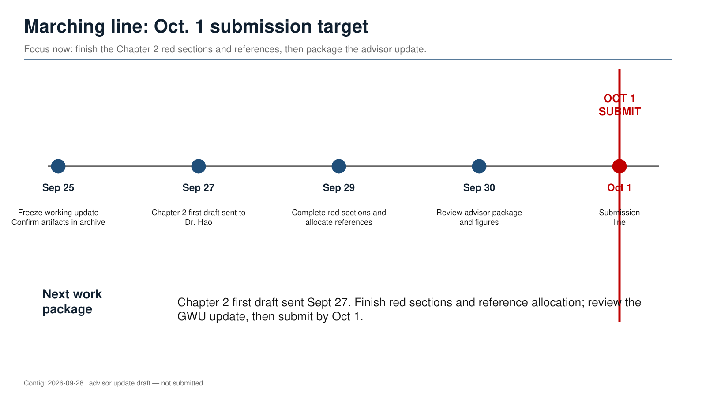
Completed Work Package: Sep. 19–Oct. 1 baseline
Focus now: what was completed after the Sep. 19 advising session and baselined for the Oct. 1 update.
OCT 1
BASELINED
Sep 19
Sep 21
Sep 23
Sep 27
Sep 29
Oct 1
Oct 3
Advisor feedback
received
Repository +
archive control
ACE / v9 workbook
+ Yasir package
Ch. 2 first
draft sent
Gold copies +
60-source register
Baseline
submission line
Advisor
session
Status at baseline
Chapter 2 first draft sent; ACE simultaneity workbook and MASDMCE guide controlled; Dr. Hao folder organized; MATLAB/SimEvents Baseline #2 queued.
Config: 2026-10-01 | advisor update baseline — v08
Notes:
Making one of these per (2) week of what was done and what I am planning next to do.

Slide 7
Tasks for the Next Two Weeks: Oct. 1–17, 2026
Focus now: turn the Oct. 1 baseline into the next advisor-ready increment for the Oct. 17 session.
Chapter 2 / literature track
Model / validation track
• Incorporate Dr. Hao feedback on Chapter 2 and the draft OV-1 when received.
• Finish the remaining red Chapter 2 sections and citation allocation.
• Hand-jam the 60+ source register into Chapter 2 as inline citations and reference entries.
• Lock the Ground-vs-Edge literature roots for DES, ACE fusion, equations and later comparisons.
• Translate the Excel ASOT logic into MATLAB/SimEvents Baseline #2.
• Reproduce workbook behavior first; then expand replications, seeds and dataset size.
• Prepare matched repeated runs, sensitivity checks and validation against independent evidence.
• Build the next advisor update package for Oct. 17 with figures, schedule and model status.
OCT 1
BASELINE
OCT 17
NEXT
Marching line
Oct 1
Oct 3
Oct 7
Oct 10
Oct 14
Oct 17
Baseline
Advisor
session
Editor/source
cleanup
Ch. 2 figures
+ citations
MATLAB
checkpoint
Next
advisor line
Config: 2026-10-01 | next two-week execution plan — v08

Slide 8
Appendix

Slide 9
Problem and Thesis Statements
Problem statement
Ground-dependent satellite data-processing architectures can create decision-support latency, bandwidth bottlenecks and operator workload when communications are degraded or intermittent.
Thesis statement
This Praxis will deliver a simulation-based systems engineering model comparing ground-centric processing with bounded orbital edge processing under degraded communications.
Research product | Intended use / contribution
Simulation-Based Evaluation Framework | Systems engineers will use the framework during early architecture trades for onboard processing under degraded communications.
MATLAB/SimEvents Model | This work contributes a public, repeatable method for evaluating orbital edge-processing performance without classified data, restricted data, or new algorithms.
Current working direction: civil ground-centric versus orbital-edge processing under matched degradation using DES, with core measures of uptime/service availability, downtime/recovery, latency, packet loss and queueing delay.
Notes:
FINAL SUBMISSION, SLIDE 2
This Praxis develops a simulation-based systems engineering framework to evaluate autonomous satellite decision support under degraded communications.
The study compares ground-centric routing against an orbital edge-processing path using public orbital data and space-weather indices.
The modeled decisions include onboard filtering, alert prioritization, downlink prioritization, resource allocation, and safe-response recommendations for ground operator review.
The framework evaluates onboard artificial intelligence and machine learning for predictive threat assessment and response.
The model assesses decision latency, operator workload, cognitive burden, and resource utilization through simulation.
The work produces a public-domain feasibility study and a preliminary Concept of Operations.
Validation compares simulated outputs against public benchmarks, theoretical delay calculations, repeated runs, and sensitivity analysis.
The research will not use classified data, develop new algorithms, or build physical hardware.
Scope of Work
SPEAKER NOTES
Modeling Autonomous Satellite Decision-Making in Contested Environments.
can an orbital edge-processing layer provide useful information to the operator faster?
The model focuses on bounded functions such as filtering, prioritizing, routing, allocating resources, and presenting recommendations.
The goal is to measure whether this architecture reduces latency, preserves communications availability, and reduces operator workload using only public, public, non-restricted data.”
FINAL SUBMISSION, SLIDE 5
(A) Deliverable | (B) Format | (C) WC
Issue | Human-in-the-loop satellite control introduces significant latency, which limits timely responses to threats in contested space environments. | 16
Reference | United States Space Force. (2020). Spacepower: Doctrine for Space Forces (CSO-P). https://www.spaceforce.mil/Portals/2/Space%20Capstone%20Publication_10%20Aug%202020.pdf | NA
”so what” | During communication denials, reliance on centralized networks slows the OODA loop, preventing timely target prioritization and jeopardizing mission survival. | 19
Reference | United States Space Force. (2025). Space Warfighting: A Framework for Planners. United States Space Force | NA
Problem statement | The multi-node communication architecture of traditional satellite control creates severe decision latency and operator cognitive burden, slowing the OODA loop and jeopardizing mission survival during communication denials. | 27
Industry | Aerospace and Defense / United States Space Force | NA
PS elaboration 1 | Round-trip data routing from operators to satellites, ground stations, and centralized continental networks creates unsustainable bottlenecks for tactical operations. | 19
PS elaboration 2 | Satellites require edge computing for limited autonomous target acquisition to maintain operational capability when disconnected from the primary network. | 19
Problem Statement
SPEAKER NOTES
FINAL SUBMISSION, SLIDE 6
(A) Deliverable | | WC
Thesis Statement | This praxis will deliver a simulation-based systems engineering model demonstrating a bounded onboard decision-making framework under degraded communications. | 18
Research Product | Simulation-Based Evaluation Framework | 4
Format | Python/MATLAB/Simulink Model | 3
Deliverable Usage | Systems engineers will use the framework during early architecture trades for onboard processing under degraded communications. | 16
Tie back to PS | The framework will address decision latency by comparing ground-centric routing with bounded onboard decision support under the same scenarios. | 18
New Contributions | This work will contribute a public, repeatable method for evaluating orbital edge-processing performance without classified data or new algorithms. | 18
Scope | The framework will apply to autonomous systems that operate with degraded communications and constrained human oversight. | 16
Main methodology | Discrete-Event Simulation | 3
Inputs | Threat Type (Categorical), Threat Proximity (km), Communication Link Status (Boolean), Satellite Resource Availability (%), AI Confidence Score (%) | NA
Outputs | Response Latency (seconds), Mission Success Probability (%), Resource Consumption (%), Correct Action Taken (Boolean) | NA
Thesis Statement
SPEAKER NOTES
The quoted July problem statement retains original terminology. It is not represented as the current civil framing; that refinement is explicitly stated on the slide.

Slide 10
Research Objectives and Questions
RQ1
Can a discrete-event systems engineering model represent satellite data-processing latency and service availability under degraded communications?
RQ2
Does bounded orbital edge processing reduce end-to-end decision-support latency and preserve service compared with a ground-centric architecture under matched degradation?
RQ3
Which parameters most affect performance: communications delay/loss, bandwidth, outage duration, processing time and alert/data priority?
PURPOSE — current scope
Evaluate bounded orbital edge processing under degraded communications; compare ground-centric routing with an edge-enabled path; provide a repeatable public-data simulation framework for early architecture trades.
Notes:
FINAL SUBMISSION, SLIDE 2
This Praxis develops a simulation-based systems engineering framework to evaluate autonomous satellite decision support under degraded communications.
The study compares ground-centric routing against an orbital edge-processing path using public orbital data and space-weather indices.
The modeled decisions include onboard filtering, alert prioritization, downlink prioritization, resource allocation, and safe-response recommendations for ground operator review.
The framework evaluates onboard artificial intelligence and machine learning for predictive threat assessment and response.
The model assesses decision latency, operator workload, cognitive burden, and resource utilization through simulation.
The work produces a public-domain feasibility study and a preliminary Concept of Operations.
Validation compares simulated outputs against public benchmarks, theoretical delay calculations, repeated runs, and sensitivity analysis.
The research will not use classified data, develop new algorithms, or build physical hardware.

Slide 11
Research Hypotheses — Proposed Refinement
H0
Under matched degradation, the ground-centric and bounded orbital-edge architectures show no measurable difference in end-to-end latency or service availability.
Test: matched DES runs; compare latency distributions, availability and downtime/recovery using confidence intervals and two-sample K-S tests.
H1
Bounded orbital edge processing reduces end-to-end decision-support latency and improves service availability relative to a ground-centric architecture under degraded communications.
Test: run identical arrival/disruption streams for both architectures; compare mean/P80/P90 latency, uptime/downtime, dropped messages and queueing delay.
For advisor discussion: effect-size thresholds and final hypothesis wording remain open. [28 Sep 2026]
Notes:
FINAL SUBMISSION, SLIDE 8
Hypothesis 1 | Discrete-event simulation will model autonomous decision latency within 15% of public benchmark ranges. | 13
Independent Variables | AI algorithm processing time (ms), Sensor data ingestion rate (kbps), Number of simulated threats (integer) | NA
Dependent Variable | Modeled response latency (seconds) | NA
Testable | The model's latency output will be compared against latency figures from unclassified literature and theoretical calculations for validation. | 18

Slide 12
5 Foundational References
EXTERNAL REFERENCE - slides 9–13
Foundational / Domestic Sources | Stated role in the Praxis
Osoba, O. A., Nacouzi, G., Hagen, J., Tran, J., Zhang, L. A., Herron, M., Lynch, C., Eisman, M., & Barton, C. (2023). The resilience assessment framework: Assessing commercial contributions to U.S. Space Force mission resilience (RR-A980-1). RAND Corporation. https://doi.org/10.7249/RRA980-1 https://www.rand.org/content/dam/rand/pubs/research_reports/RRA900/RRA980-1/RAND_RRA980-1.pdf | Resilience assessment and degraded-performance comparison.
National Aeronautics and Space Administration. (2013). Space Communications and Navigation (SCaN) Network Architecture Definition Document (ADD) Executive Summary, Volume 1, Revision 4. NASA. (https://www.nasa.gov/wp-content/uploads/2023/09/scan-add-vol1rev4.pdf) | Ground-station and relay-network architecture; not live performance data.
Kodheli, O., Lagunas, E., Maturo, N., et al. (2021). Satellite communications in the new space era: A survey and future challenges. IEEE Communications Surveys & Tutorials, 23, 70–109. https://ieeexplore.ieee.org/document/9210567 | Satellite communications survey and onboard-processing context.
CelesTrak. (n.d.). NORAD GP element sets: Current data. https://celestrak.org/NORAD/elements/? | Orbital elements for visibility/access assumptions.
National Oceanic and Atmospheric Administration, Space Weather Prediction Center. (n.d.). Planetary K-index. https://www.spaceweather.gov/products/planetary-k-index? | Environmental proxy for degradation scenarios; not direct latency.
Notes:
FINAL SUBMISSION, SLIDE 9
Reference | Osoba, O. A., Nacouzi, G., Hagen, J., Tran, J., Zhang, L. A., Herron, M., Lynch, C., Eisman, M., & Barton, C. (2023). The resilience assessment framework: Assessing commercial contributions to U.S. Space Force mission resilience (RR-A980-1). RAND Corporation. https://doi.org/10.7249/RRA980-1
https://www.rand.org/content/dam/rand/pubs/research_reports/RRA900/RRA980-1/RAND_RRA980-1.pdf
| NA
Summary | RAND develops a framework for assessing how architecture changes affect space mission resilience. The framework combines physics-based modeling and statistical systems analysis. | 22
Methodology | Physics-based modeling and statistical systems analysis. | NA
Evaluation | The source is reliable because RAND developed it for USSF mission-resilience assessment.
The limitation is that it evaluates resilience broadly, not orbital edge processing specifically. | 24
Relevance | This source supports architecture-resilience evaluation and degraded-mission performance comparison for my simulation framework.
It helps connect public modeling assumptions to mission-resilience measures without requiring classified data. | 23
Annotated Bibliography
RAND Corp
SPEAKER NOTES
FINAL SUBMISSION, SLIDE 10
Reference | National Aeronautics and Space Administration. (2013). Space Communications and Navigation (SCaN) Network Architecture Definition Document (ADD)
Executive Summary, Volume 1, Revision 4. NASA. (https://www.nasa.gov/wp-content/uploads/2023/09/scan-add-vol1rev4.pdf)
| NA
Summary | NASA describes communications architecture assets, options, and network evolution.
The document links architecture decisions to future mission communications requirements. | 19
Methodology | Architecture definition. | NA
Evaluation | The advantage is that it is civil-space focused, not DoD-specific.
The source is reliable because it is a NASA architecture document. | 21
Relevance | This source supports the ground-station and relay-network portion of my model.
It helps justify modeling communications paths as architecture trade variables. | 22
Annotated Bibliography
NASA SCaN Architecture (Space Communications and Navigation Network )
SPEAKER NOTES
FINAL SUBMISSION, SLIDE 11
Reference | Kodheli, O., Lagunas, E., Maturo, N., et al. (2021). Satellite communications in the new space era: A survey and future challenges. IEEE Communications Surveys & Tutorials, 23, 70–109.
https://ieeexplore.ieee.org/document/9210567
| NA
Summary | The article surveys modern satellite communications and future research challenges.
It identifies onboard processing and space-based data processing as innovation drivers but provides quality standard baselines to measure from. | 21
Methodology | Literature Survey | NA
Evaluation | The source is reliable because it is a highly cited IEEE survey.
The limitation is that it covers many topics beyond my specific model. | 24
Relevance | This source supports onboard processing as a legitimate satellite communications research area.
It helps connect my edge-processing layer to current satellite network research. | 23
Annotated Bibliography
IEEE Communications Surveys
SPEAKER NOTES
FINAL SUBMISSION, SLIDE 12
Reference | CelesTrak. (n.d.). NORAD GP element sets: Current data.
https://celestrak.org/NORAD/elements/?
| NA
Summary | CelesTrak provides public General Perturbations data for orbital modeling.
The data supports repeatable satellite visibility and access assumptions. | 18
Methodology | Public orbital data publication. | NA
Evaluation | The limitation is that public GP data supports notional analysis, not operational precision.
The source is useful because it provides open orbital data. | 23
Relevance | This source provides public orbital context for my MATLAB simulation.
It helps keep the research unclassified, repeatable, and auditable. | 19
Annotated Bibliography
CelesTrak Public Orbital Data
SPEAKER NOTES
FINAL SUBMISSION, SLIDE 13
Reference | National Oceanic and Atmospheric Administration, Space Weather Prediction Center. (n.d.). Planetary K-index.
https://www.spaceweather.gov/products/planetary-k-index?
| NA
Summary | NOAA provides public space-weather products used to characterize geomagnetic disturbances.
Kp helps represent environmental conditions that can affect space and communications systems. | 22
Methodology | Operational environmental observation. | NA
Evaluation | The source is reliable because it is an official NOAA operational product.
The limitation is that Kp is an environmental proxy, not a direct latency measure. | 25
Relevance | This source provides public environmental inputs for simulated degradation scenarios.
It supports unclassified modeling of space-weather effects without using sensitive disruption assumptions.
The proxy is that Kp is an environmental proxy, not a direct man-made measure. | 22
Annotated Bibliography
NOAA Space Weather / Kp Index
SPEAKER NOTES
URLs and author strings are preserved from the final submission. The five entries are a separate snapshot, not added to the 31-work GWU register count.

Slide 13
Data Sources — Current Simultaneity Stack and Supporting Candidates
ASOT event window: 28 Jan. 2022, 17:42–17:55 UTC. The first three sources are the simultaneous baseline; the last two remain supporting / foreign context candidates.
ACE role | Source / owner | Status | Use in workbook | Boundary / note
A — AI/ML | OPSSAT-AD v2 (dataset.csv + segments.csv) | SIMULTANEOUS Direct OPS-SAT | Telemetry / task leg; establishes observation and AI/ML workload timing. | Same OPS-SAT event window; bounded to accepted cohort.
C — Comms | SatNOGS OPS-SAT telemetry OPS-SAT / NORAD 44878 | SIMULTANEOUS Direct OPS-SAT | Communications leg; reception / decoded telemetry and accepted link associations. | Same spacecraft; not treated as full network-performance truth.
E — Environmental | NASA OMNI 1-minute High-res space environment | SIMULTANEOUS Context window | Environmental context for the same UTC interval. | Not OPS-SAT telemetry; association/context, not automatic causation.
Support — ENV | Antarctica / CINC ionosonde foreign environmental context | SUPPORTING Non-ASOT | Adds environmental/ionospheric precedent and citation support. | Not part of current simultaneous OPS-SAT cohort.
Support — COMM | CAIDA / external network-measurement candidate | SUPPORTING Non-ASOT | Supports comms-measurement framing and degradation literature. | Keep separate from ASOT unless time-overlap is later verified.
ASOT = first three simultaneous sources only. Supporting sources strengthen Chapter 2 and scenario logic, but they do not replace the synchronized OPS-SAT ACE cohort.
The supporting sources established and support the Env/Comm buckets.
Notes:
SOURCE: International_Research_Data_POC_Register_2026-09-13_v05_Battle_Rhythm.xlsx, POC Register, Research Fit, Source Status and Australia Sources. The snapshot reports prior correspondence, not newly verified public web content.
Germany: https://github.com/sys-uos ; latest dataset referral https://doi.org/10.26249/FK2/YXPS4G ; associated paper referral https://doi.org/10.1145/3789240.3827586 . Distinguish WetLinks from related/newer datasets when selecting actual files; as-is, no extended support.
Canada: https://onlineacademiccommunity.uvic.ca/starlink/ ; specific files/fields pending.
Australia: Cassie Marshall email of 13 Sep 2026; ASWFC@bom.gov.au. Eight links: https://rudimirz.com/flares/ ; https://listserver.ips.gov.au/pipermail/ips-swf-alert/ ; https://www.sws.bom.gov.au/World_Data_Centre/1/3 ; https://listserver.ips.gov.au/pipermail/ips-mag-alert/ ; https://sws-data.sws.bom.gov.au/ ; https://kp.gfz.de/en/ ; https://listserver.ips.gov.au/pipermail/ips-dsgr/ ; https://www.sws.bom.gov.au/Products_and_Services/4/1 . Bureau material: cite ASWFC/Bureau. X-ray flux: cite original source, not Bureau.
SANSA: targeted RFI sent to mtshisaphungo@sansa.org.za cc spaceweather@sansa.org.za at 15:30 Pacific, 13 Sep 2026.
Japan: iono@ml.nict.go.jp .
FINAL SUBMISSION, SLIDE 16
ID | Name | Source | Brief Description | Format | Time Span | Num. of records | Access
(Y/N)
1 | Orbital Data | Celestrak NORAD GP Element Sets: Current Data | Public orbital elements support satellite visibility and route availability assumptions. | CSV/JSON | Current Scenario snapshot/sample | 30 records | Y
2 | Space Weather | NOAA SWPC Planetary K-Index | Kp values represent geomagnetic/solar storm severity for degraded communications scenarios. | CSV/HTML | Per 30 day window sample period | 240 intervals | Y
3 | Ground Weather | NOAA Local Climate Data | Hourly weather observations support ground-station availability assumptions near a notional antenna for example. | CSV | Per 30 day window sample period | 720 hourly records | Y
4 | C2 Architecture Baseline | NASA SCaN Network Architecture Definition Document, Vol 1, Rev 4 | Architecture descriptions support baseline ground-station and relay network path assumptions. | CSV/PDF | 2013 publication | 1 doc | Y
5 | Resilience Metrics | RAND Resilience Assessment Framework | Resilience framework supporting degraded mission performance comparison. | CSV/PDF | 2023 publication
| 1 doc | Y
6 | Scenario Vectors | Author created MATLAB scenario table | Simulation vectors control outage duration, bandwidth reduction, processing time, and threshold limits. | CSV/MAT | Simulation period | 10,000 runs | Y
Data Sources List
SPEAKER NOTES
Shown up-front, the model does not use classified data, restricted data, or internal program data.
The sources either provide public inputs for the simulation or support the assumptions behind the model.
The key point is traceability: every input has a sourced and I updated the earlier slides with the hyperlinks per Instructor feedback.
FINAL SUBMISSION, SLIDE 17
Use public orbital elements to calculate satellite visibility, access windows, and route availability.
Data Treatment:
Select a limited satellite subset aligned to the notional scenario.
Convert all timestamps to UTC for simulation data normalization across the fields.
Filter records with missing or stale orbital elements.
CelesTrak Example
ID | Name | Source | Brief Description | Format | Time Span | Num. of records | Access
(Y/N)
1 | Orbital Data | Celestrak NORAD GP Element Sets: Current Data | Public orbital elements support satellite visibility and route availability assumptions. | CSV/JSON | Current Scenario snapshot/sample | 30 records | Y
Object_Name | NORAD_CAT_ID | EPOCH | INCLINATION | MEAN_MOTION
Sat1 | 001 | UTC Timestamp | degrees | rev/day
Sat2 | 002 | UTC Timestamp | degrees | rev/day
Sat3 | 003 | UTC Timestamp | degrees | rev/day
Sample Data:
SPEAKER NOTES
CelesTrak provides public satellite orbital data. I use it to estimate satellite visibility, access windows, and route availability.
FINAL SUBMISSION, SLIDE 18
Use Kp values to represent space weather degradation severity during simulated communications scenarios.
Data Treatment:
Convert Kp readings into normal, degraded, and severe categories
Align three hour Kp intervals to the simulation clock
Flag missing intervals rather than assuming valid conditions
NOAA Space Weather Prediction Center (SWPC) Kp Example
ID | Name | Source | Brief Description | Format | Time Span | Num. of records | Access
(Y/N)
2 | Space Weather | NOAA SWPC Planetary K-Index | Kp values represent geomagnetic/solar storm severity for degraded communications scenarios. | CSV/HTML | Per 30 day window sample period | 240 intervals | Y
UTC_Time | KP_INDEX | DEGRADATION_LEVEL
7/1/2026 0:00 | 2 | Normal
7/1/2026 3:00 | 5 | Degraded
7/1/2026 6:00 | 7 | Severe
Sample Data:
SPEAKER NOTES
The NOAA Space Weather Prediction Center provides Kp and related space-weather information. I use this to represent environmental conditions that may degrade communications.
FINAL SUBMISSION, SLIDE 19
Use of weather observations to estimate ground station availability representing a notional remote antenna, the Remote Ground Station (RGS).
Data treatment:
Select the nearest public weather station to the notional antenna
Standardize solar, electro-magnetic/polar or gravimetric data
Convert weather values into availability-impact scores.
NOAA National Centers for Environmental Information Weather (NCEI) Example
ID | Name | Source | Brief Description | Format | Time Span | Num. of records | Access
(Y/N)
3 | Ground Weather | NOAA Local Climate Data | Hourly weather observations support ground-station availability assumptions near a notional antenna for example. | CSV | Per 30 day window sample period | 720 hourly records | Y
UTC_TIME | SOURCE | VARIABLE | VALUE | UNIT | DEGRADATION_LEVEL | AVAILABILITY_IMPACT
2026_07_01 00:00 | NOAA NCEI LCD | Visibility | 8 | km | km | Normal
2026_07_01 03:00 | NOAA SWPC Kp | Kp Index | 6 | index | index | Degraded
2026_07_01 04:30 | NOAA GOES X-ray | Radio Blackout | R1 | category | category | Degraded
2026_07_01 06:15 | USGS Earthquake API | Magnitude | 5.6 | Mw | Mw | Severe
Sample Data:
SPEAKER NOTES
The NOAA National Centers for Environmental Information provides historical ground-weather observations near a notional remote ground station.
FINAL SUBMISSION, SLIDE 20
Use public architecture descriptions to define baseline ground station and relay network assumptions.
Data treatment:
Extract architecture elements relevant to the ground, relay and user segments for modeling
Convert qualitative architecture descriptions into notional model states.
Cite derived assumptions rather than treating them as measured data.
NASA SCaN Example
ID | Name | Source | Brief Description | Format | Time Span | Num. of records | Access
(Y/N)
4 | C2 Architecture Baseline | NASA SCaN Network Architecture Definition Document, Vol 1, Rev 4 | Architecture descriptions support baseline ground-station and relay network path assumptions. | CSV/PDF | 2013 publication | 1 doc | Y
ARCHITECTURE_ELEMENT | MODEL_VARIABLE | SIMULATION_ROLE
Ground station | RGS Availability | Baseline path gate
Relay network | Route availability | Alternate path support
User segment | Operator receipt | Decision support endpoint
Sample Data:
SPEAKER NOTES
The NASA SCaN architecture document is not a live dataset. It provides the public architecture baseline for ground stations, relay networks, and communications paths.
FINAL SUBMISSION, SLIDE 21
Use resilience concepts to define degraded mission performance measures and decision criteria.
Data treatment:
Retrieve resilience concepts and ideas relevant to latency, availability, and degradation
Map the concepts and ideas to a measurable simulation output
Use this for methodology support, not direct operational data
RAND Example
ID | Name | Source | Brief Description | Format | Time Span | Num. of records | Access
(Y/N)
5 | Resilience Metrics | RAND Resilience Assessment Framework | Resilience framework supporting degraded mission performance comparison. | CSV/PDF | 2023 publication | 1 doc | Y
RESILIENCE_CONCEPT | MODEL_METRIC | DECISION_CRITERION
Degradation | Path availability (%) | Maintains threshold
Recovery | Recovery time (s) | Restores service
Mission performance | Response latency (s) | Improves baseline
Sample Data:
SPEAKER NOTES
The RAND Resilience Assessment Framework provides resilience concepts and performance measures that help define degradation, recovery, and mission-performance criteria.
FINAL SUBMISSION, SLIDE 22
Use controlled simulation inputs to vary degradation, routing, processing, and decision thresholds.
Data treatment:
Generate values from documented distributions and fixed random seeds.
Store each run as a reproducible MATLAB input table
Conduct sensitivity analysis by varying one driver at a time
Scenario Vectors Example
ID | Name | Source | Brief Description | Format | Time Span | Num. of records | Access
(Y/N)
6 | Scenario Vectors | Author created MATLAB scenario table | Simulation vectors control outage duration, bandwidth reduction, processing time, and threshold limits. | CSV/MAT | Simulation period | 10,000 runs | Y
RUN_ID | CONTROL_MODE | COMM_DELAY | RGS_Available | EDGE_PROCESSING | AI_CONFIDENCE_%
1 | Ground-centric | 7.5 | TRUE | 0 | 0
2 | Edge Enabled | 3.2 | FALSE | 0.8 | 82
3 | Edge Enabled | 4.1 | FALSE | 1.1 | 76
Sample Data:
SPEAKER NOTES
Finally, I create a controlled MATLAB scenario table. This combines the public inputs into repeatable events such as an outage, bandwidth reduction, packet loss, processing delay, and recovery.

Slide 14
Summary of Methodology
DES — WORKING SELECTION
Element | Working design / source-derived content
Method | Follow individual observations, disruptions, routing, processing, responses and recovery in event order. Compare ground-centric and orbital-edge paths under matched degradation.
Inputs | Disruption type/start/duration; communication lag; ground-station availability; visibility window; bandwidth capacity; data volume; packet loss; edge processing time; resource availability.
Outputs | Uptime/service availability; downtime/recovery; response latency; packet loss; queueing delay. Recovery and dropped messages remain supporting observations. Definitions and thresholds still need to be fixed.
Analysis | Public benchmarks and theoretical delay calculations; matched repeated runs; latency-distribution comparison; sensitivity analysis.
Implementation / boundary | MATLAB/SimEvents primary; Python only optional for data ingestion/preprocessing; reproducible scenario tables with fixed random seeds.
Notes:
FINAL SUBMISSION, SLIDE 2
This Praxis develops a simulation-based systems engineering framework to evaluate autonomous satellite decision support under degraded communications.
The study compares ground-centric routing against an orbital edge-processing path using public orbital data and space-weather indices.
The modeled decisions include onboard filtering, alert prioritization, downlink prioritization, resource allocation, and safe-response recommendations for ground operator review.
The framework evaluates onboard artificial intelligence and machine learning for predictive threat assessment and response.
The model assesses decision latency, operator workload, cognitive burden, and resource utilization through simulation.
The work produces a public-domain feasibility study and a preliminary Concept of Operations.
Validation compares simulated outputs against public benchmarks, theoretical delay calculations, repeated runs, and sensitivity analysis.
The research will not use classified data, develop new algorithms, or build physical hardware.
Scope of Work
SPEAKER NOTES
Modeling Autonomous Satellite Decision-Making in Contested Environments.
can an orbital edge-processing layer provide useful information to the operator faster?
The model focuses on bounded functions such as filtering, prioritizing, routing, allocating resources, and presenting recommendations.
The goal is to measure whether this architecture reduces latency, preserves communications availability, and reduces operator workload using only public, public, non-restricted data.”
FINAL SUBMISSION, SLIDE 6
(A) Deliverable | | WC
Thesis Statement | This praxis will deliver a simulation-based systems engineering model demonstrating a bounded onboard decision-making framework under degraded communications. | 18
Research Product | Simulation-Based Evaluation Framework | 4
Format | Python/MATLAB/Simulink Model | 3
Deliverable Usage | Systems engineers will use the framework during early architecture trades for onboard processing under degraded communications. | 16
Tie back to PS | The framework will address decision latency by comparing ground-centric routing with bounded onboard decision support under the same scenarios. | 18
New Contributions | This work will contribute a public, repeatable method for evaluating orbital edge-processing performance without classified data or new algorithms. | 18
Scope | The framework will apply to autonomous systems that operate with degraded communications and constrained human oversight. | 16
Main methodology | Discrete-Event Simulation | 3
Inputs | Threat Type (Categorical), Threat Proximity (km), Communication Link Status (Boolean), Satellite Resource Availability (%), AI Confidence Score (%) | NA
Outputs | Response Latency (seconds), Mission Success Probability (%), Resource Consumption (%), Correct Action Taken (Boolean) | NA
Thesis Statement
SPEAKER NOTES
FINAL SUBMISSION, SLIDE 14
Methodology 1
A) Deliverable | B) Content | C) WC
Methodology | Discrete-Event Simulation | 3
Inputs | The Disruption Event Type (categorical), event start times (s), event duration (min), communication lag, ground station availability (Boolean), satellite visibility window (min), bandwidth capacity (Mbps), data volume (MB), packet loss rate (%), edge processing times, AI confidence score (%), satellite resource availability (%) | NA
Outputs | Response latency, OODA Loop decision cycle times, path availability (%), dropped messages (count), recovery time, operator workflow reduction comparison (%), correct action selection (%). | NA
SPEAKER NOTES
Methodology 1 — Discrete-Event Simulation
Method:
“My first methodology is discrete-event simulation. It follows specific events in order—such as a request arriving, the ground-station path failing, the edge cloud processing the request, and a response reaching the operator.”
Inputs:
“The inputs include the disruption type, when it starts, how long it lasts, communication delay, processing time, and available resources.”
Outputs:
“The outputs include response latency, OODA-loop time, path availability, dropped messages, recovery time, workload reduction, and what % of the time the correct response was selected.”
Purpose:
“This method shows what happens during each individual disruption and compares the ground-centric path with the edge-enabled path.”
FINAL SUBMISSION, SLIDE 15
Methodology 2
A) Deliverable | B) Content | C) WC
Methodology | System Dynamic Simulation | 3
Inputs | Time step(s), simulation duration (hr), path availability (%), bandwidth capacity (Mbps), data volume rate (MB/min), Kp index (0-9), weather severity index (0-1), queue depth (count), edge compute load (%) resource availability (%), AI confidence score (%) | NA
Outputs | Average response latency, 95th percentile latency, OODA loop times, path availability (%), bandwidth demand (Mbps), queue growth rate (messages/min), operator workflow trends (count/hr), resource consumption (%), mission success probability (%).
Dropped messages (count), recovery time, operator workflow reduction comparison, correct action selection (%).
| NA
SPEAKER NOTES
Methodology 2 — System Dynamics Simulation
Method:
“My second methodology is system dynamics simulation. It looks at how the entire system behaves and changes over a longer period of time.”
Inputs:
“The inputs include simulation time, path availability, incoming data rate, space-weather severity, and available resources.”
Outputs:
“The outputs include average latency, 95th-percentile latency, OODA-loop trends, operator workload, resource use, and % mission-success over time.”
Purpose:
“This method shows whether the edge-enabled architecture remains effective as degraded conditions continue.
What happens during on-going disruption and compares the ground-centric path with the edge-enabled path.”
Transition:
“Methodology 1 shows what happens event by event. Methodology 2 shows how performance changes over time.”
FINAL SUBMISSION, SLIDE 22
Use controlled simulation inputs to vary degradation, routing, processing, and decision thresholds.
Data treatment:
Generate values from documented distributions and fixed random seeds.
Store each run as a reproducible MATLAB input table
Conduct sensitivity analysis by varying one driver at a time
Scenario Vectors Example
ID | Name | Source | Brief Description | Format | Time Span | Num. of records | Access
(Y/N)
6 | Scenario Vectors | Author created MATLAB scenario table | Simulation vectors control outage duration, bandwidth reduction, processing time, and threshold limits. | CSV/MAT | Simulation period | 10,000 runs | Y
RUN_ID | CONTROL_MODE | COMM_DELAY | RGS_Available | EDGE_PROCESSING | AI_CONFIDENCE_%
1 | Ground-centric | 7.5 | TRUE | 0 | 0
2 | Edge Enabled | 3.2 | FALSE | 0.8 | 82
3 | Edge Enabled | 4.1 | FALSE | 1.1 | 76
Sample Data:
SPEAKER NOTES
Finally, I create a controlled MATLAB scenario table. This combines the public inputs into repeatable events such as an outage, bandwidth reduction, packet loss, processing delay, and recovery.
FINAL SUBMISSION, SLIDE 24
Methodology 1 Map
SPEAKER NOTES
Methodology 1: discrete-event simulation. This method follows individual events in sequence—disruption, routing, edge processing, operator response, and recovery. It helps answer whether the model can credibly measure response latency and path availability during a specific disruption.”
Summary combines clearly labeled current scope with inputs and planned analysis in the July source. Complete original DES inputs/outputs, including AI-confidence and operator/action metrics, are retained above as baseline notes; they are not silently asserted as current core measures. No sample figures in the final submission are claimed as downloaded measurements or executed simulation results.

Slide 15
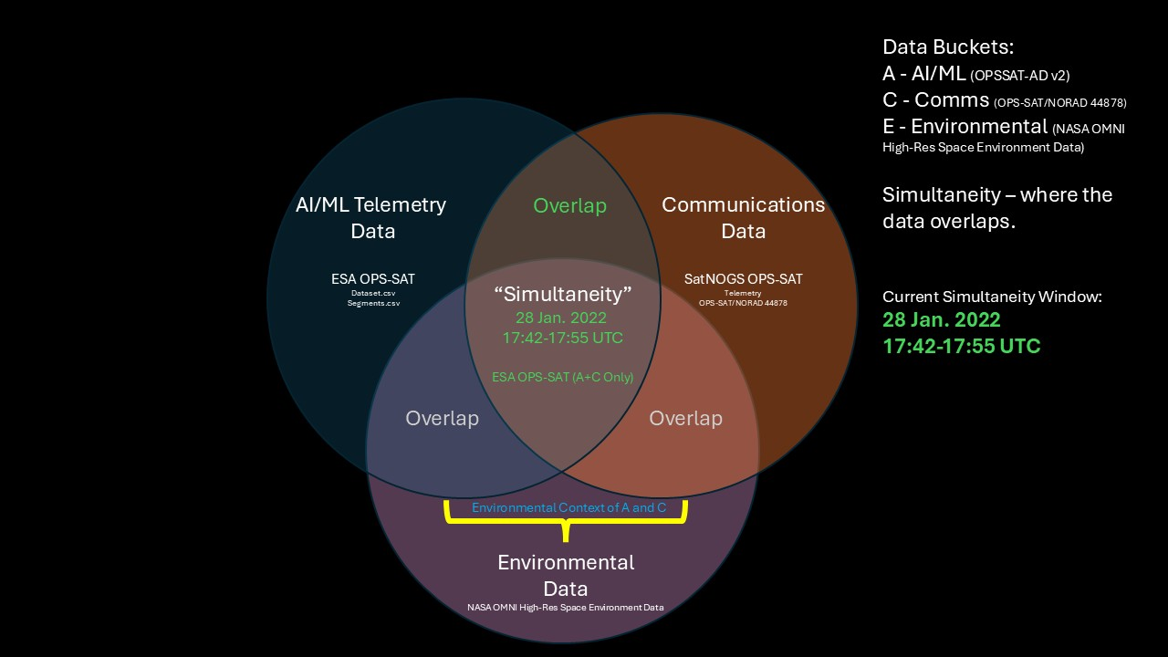
Notes:
Backup figure from draft OV-1 v3, received 28 Sep 2026. The intersection is a shared timestamp window, not proof that environment caused communications behavior. Source labels and field qualification remain subject to review.

Slide 16
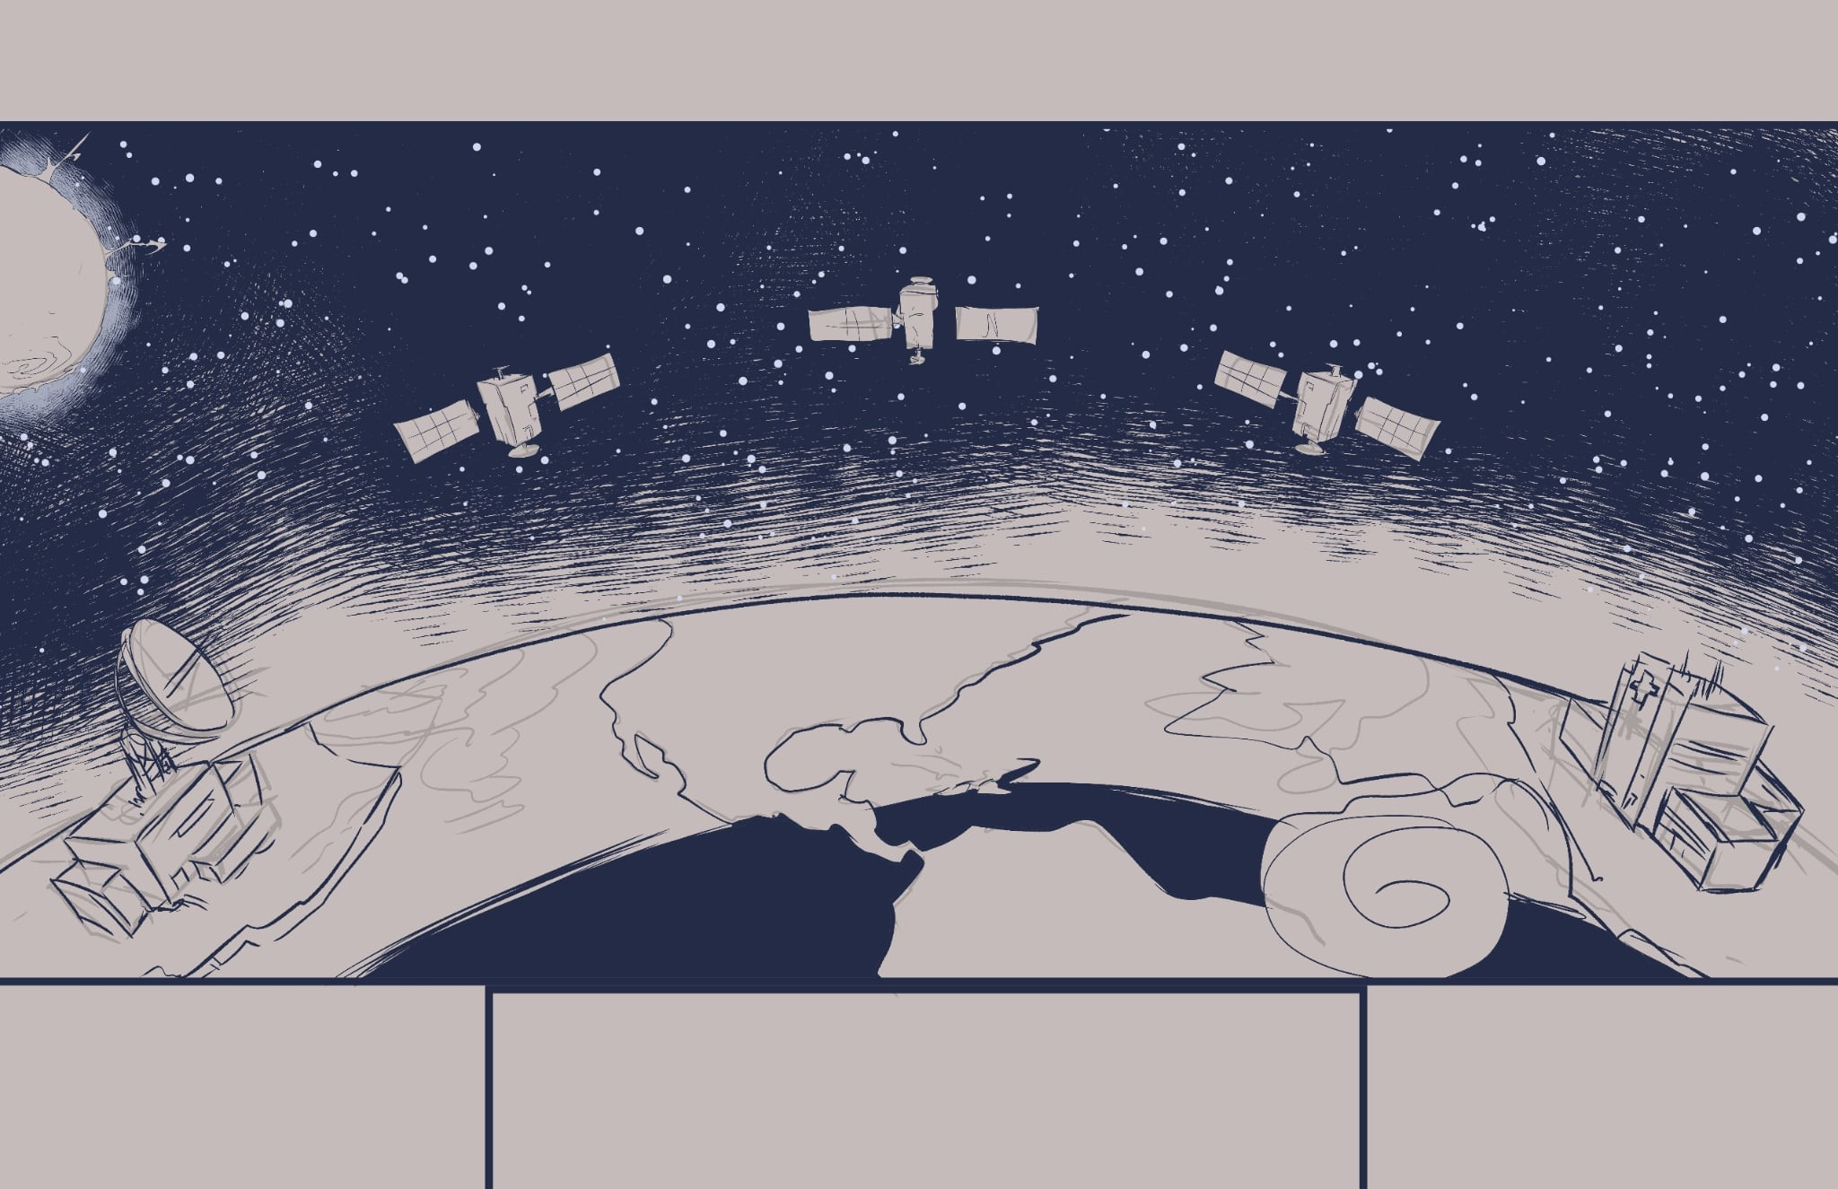







Modeling Autonomous Satellite Decision-Making in Contested Environments
The Challenge: Ground-Centric Operations
Problem: Relies on constant, vulnerable ground station links.
Impact: Significant decision latency from data round-trips.
Vulnerability: Ineffective when communications are jammed or lost.
The Solution: MEO Edge Processing
Concept: Perform data processing and analysis directly on the satellite.
Benefit: Radically reduces latency by enabling real-time, on-board decisions.
Outcome: Creates a more autonomous, resilient, and cost-effective constellation.
The Payoff: Quantified Mission Impact
Metric 1 (Latency): Measures the precise reduction in sensor-to-decision time.
Metric 2 (Autonomy): Assesses the satellite's ability to operate independently.
Metric 3 (Efficiency): Quantifies bandwidth savings and data quality improvements.

Slide 17
Workbook Rosetta — Tab Colors, Cohorts, and Data Flow
How to read the ASOT workbook: raw A/C/E inputs are normalized, joined, converted into arrivals, run through matched Ground and Edge paths, then summarized for dashboard and MATLAB handoff.
Raw A/C/E | Normalize | Join / Audit | Arrivals | Ground + Edge | Compare / Stats | Dashboard + MATLAB
→ | → | → | → | → | → | OUTPUT
Color | Family | Representative tabs | What happens there | Reviewer cue
Blue | Executive control | DASHBOARD, INTRO, Settings, Protocol, Provenance | Defines purpose, schema, control dials, and provenance. | Start here. Explains what the workbook is and what is adjustable.
Green | Core cohort / DES engine | Arrivals, RGS_Ground_Run, Edge_Run, Comparison | Same arrivals are processed through Ground and Edge paths; Comparison calculates latency delta. | This is the mathematical heart. Do not reorder.
Brown | Analysis and statistics | Replications, Sensitivity, Scenario_Snapshots, Latency_Bins, A/C/E snapshots | Aggregates runs, shows sensitivity, creates dashboard/histogram support. | This is where results become reviewer-readable.
Yellow | Verification and audit | Hand_Check, _Build_Check, Validation | Checks formulas, first records, validation rules, and calculation integrity. | Evidence that the workbook was checked.
Purple | Integration blenders | Simul_Enviro_OMNI_Normalized, Integration_Join_Audit, Integration_Common_Timeline | Normalizes and time-aligns AI/ML, COMM, and ENV into the common ACE timeline. | Shows how raw data became model input.
Orange | COMM decoders | COMM_Decoded, COMM_Beacons, COMM_Counter_Deltas, COMM_Rejected, Field Map, Decode QC | Decodes SatNOGS telemetry and records accepted/rejected communication fields. | Supports the C leg and QC traceability.
Grey | Raw / utility / history | Raw Simultaneity sheets, MATLAB_Map, MATLAB_Handoff, Change_Log, v9 Readme, ACE legacy input | Stores raw data, handoff tables, history, and MATLAB support. | Reference and configuration control layer.
Immutable sequence rule: names may be interpreted dynamically, but the 1–38 tab order is treated as ASOT configuration control; do not drag/reorder tabs.

Slide 18
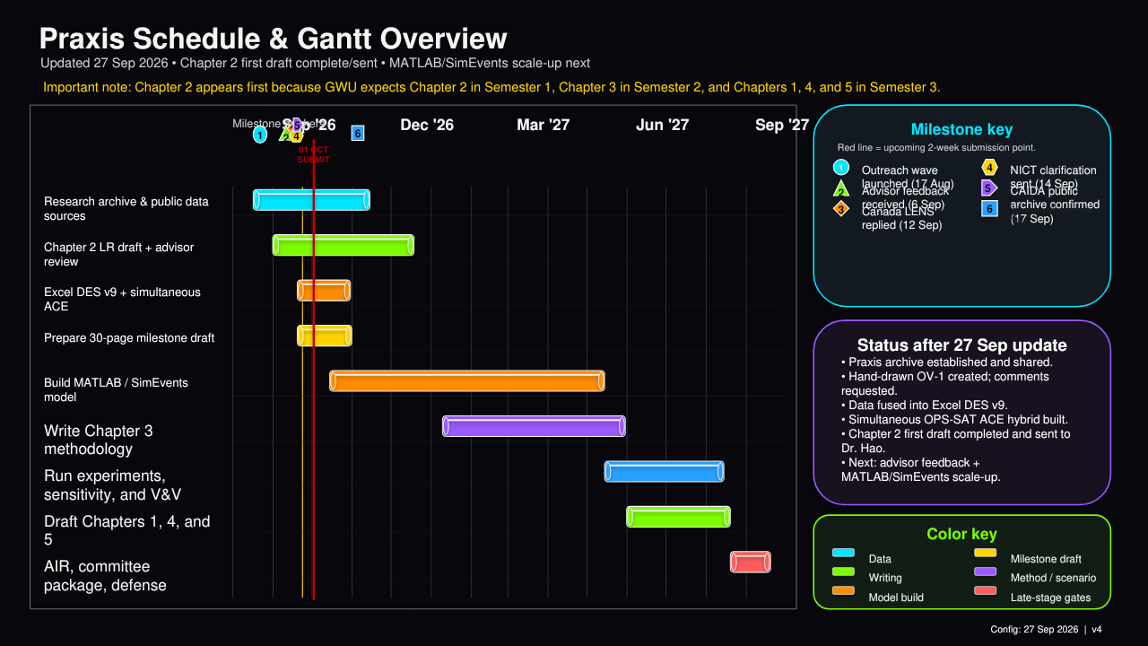
Praxis Schedule & Gantt Overview
Updated 01 Oct 2026 • Oct. 1 baseline complete • Oct. 17 next advisor deadline
Important note: Chapter 2 appears first because GWU expects Chapter 2 in Semester 1; Chapter 3 follows after the literature foundation is satisfactory.
Oct '26
Nov '26
Dec '26
Mar '27
Jun '27
Milestone key
01 OCT
BASELINE
1
Oct. 1 — baseline package
Research archive & public data sources
17 OCT
NEXT
2
Oct. 3 — advisor session
3
Oct. 17 — next deck/advising line
Chapter 2 LR draft + advisor review
4
Oct. 29 — advisor deck due
5
Nov. 1 — 30-page milestone
Excel DES v9 + simultaneous ACE
Prepare 30-page milestone draft
Status after Oct. 1 baseline
Build MATLAB / SimEvents model
• Chapter 2 first draft sent; advisor feedback pending.
• ACE ASOT workbook + MASDMCE guide controlled.
• Gold copies and 60+ source register in folder.
• Next: Chapter 2 citations, figures, MATLAB baseline.
Write Chapter 3 methodology
Run experiments, sensitivity, and V&V
Draft Chapters 1, 4, and 5
Color key
Data
Milestone draft
AIR, committee package, defense
Writing
Method / scenario
Model build
Late-stage gates
Config: 2026-10-01 | v08

Slide 19
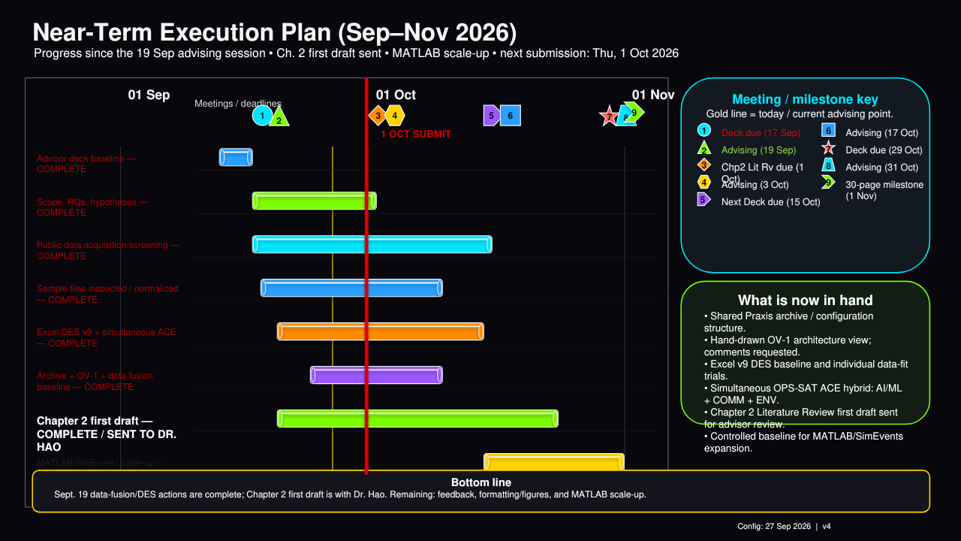
Near-Term Execution Plan (Oct. 1–17, 2026)
Baseline: Oct. 1 submission package • Next advisor-deck deadline / session line: Oct. 17
01 Oct
03 Oct
07 Oct
10 Oct
14 Oct
Meeting / milestone key
1 OCT
BASELINE
17 OCT
NEXT
1
Oct. 1 — baseline submitted
Advisor session / questions
2
Oct. 3 — advisor session
Ask: Ch. 2 sufficiency, OV-1, figures, equations
3
Oct. 17 — next update/advising line
Chapter 2 red sections + inline citations
4
Nov. 1 — 30-page milestone path
Finish prose; integrate 60+ register sources
Editor reference cleanup
Resolve incomplete APA entries
Bottom line
OV-1 + DES / ACE figures
Roberto + PPT figures; keep causal limits explicit
• Oct. 1 is the baseline, not the suspense.
• Oct. 17 is the next two-week gate.
• Primary risk: Chapter 2 source integration.
• MATLAB must reproduce Excel before scaling.
MATLAB/SimEvents Baseline #2
Reproduce Excel ASOT; fixed RNG / seeds
Validation + sensitivity plan
Matched repeated runs; confidence intervals
Oct. 17 advisor deck
Package status, risks, asks
Bottom line: convert the Oct. 1 package into a cleaner Chapter 2 + reproducible MATLAB baseline by Oct. 17.
Config: 2026-10-01 | v08

Slide 20
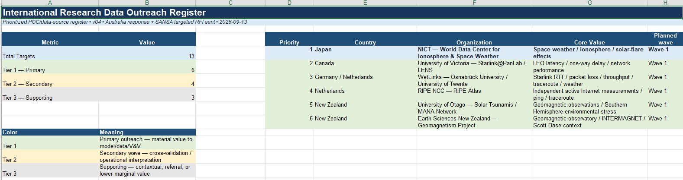
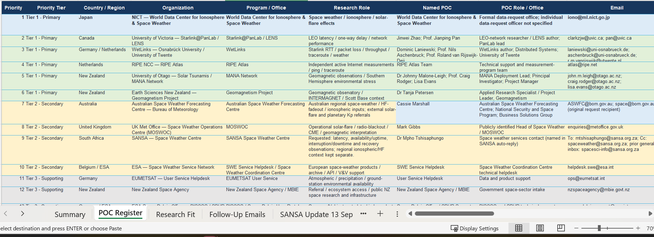

Slide 22
AIS Cohort Architecture — Company / Technology Register
Heat reflects relevance to the Praxis solution space, not vendor quality or endorsement.
Layer / Tier | Layer Name | Layer Function | Company | Technology / Descriptor from Slide | Praxis Relevance | Heat | Rationale
5 | Cognitive Layer | Autonomous Software & AI/ML | Advanced Space | SIREN autonomous OODA | Direct AI/ML edge decision-cycle relevance | HOT | Closest fit to autonomous onboard decision support and OODA compression.
5 | Cognitive Layer | Autonomous Software & AI/ML | Force AI | STARHELM secure Rust runtime | Edge software/runtime relevance | HOT | Directly relevant to onboard autonomous software execution.
5 | Cognitive Layer | Autonomous Software & AI/ML | Zenith Space | Cislunar CR3BP normal forms | Autonomy / onboard reasoning adjacency | WARM | Useful autonomy mathematics, but less direct to latency/edge-processing experiments.
5 | Cognitive Layer | Autonomous Software & AI/ML | EraDrive | Era-AI NLP foundation model | AI orchestration / operator support | HOT | Strong human-machine teaming and AI-assisted decision-support relevance.
5 | Cognitive Layer | Autonomous Software & AI/ML | O-Astra ISR | LOGAN pre-approved guard | Autonomous ISR / bounded action logic | HOT | Direct fit to bounded autonomous sensing-to-action concepts.
5 | Cognitive Layer | Autonomous Software & AI/ML | In Orbit Aerospace | INTELLACT zero-hallucination AI | Explainable / reliable onboard AI | HOT | Strong model-credibility and autonomous decision-support relevance.
5 | Cognitive Layer | Autonomous Software & AI/ML | Seekr Technologies | SeekrFlow multi-agent AI | AI orchestration / multi-agent coordination | HOT | Strong fit to autonomous agents and workload triage.
5 | Cognitive Layer | Autonomous Software & AI/ML | PiLogic | Manifest exact CPU-only AI | Compute-constrained edge AI | HOT | Directly relevant to bounded onboard compute and SWaP constraints.
5 | Cognitive Layer | Autonomous Software & AI/ML | Synthetic | SUBSPACE on-orbit reconfigurable ML | On-orbit adaptive ML | HOT | Direct edge-ML and adaptive onboard processing relevance.
4 | Networking Layer | Secure Routing & Timing | Ephemeris Net | SEP optical Layer 3 routing | Optical networking / routing / DDIL | HOT | Direct link to crosslinks, routing, downlink bypass, and communications latency.
4 | Networking Layer | Secure Routing & Timing | Picogrid | MARSO/Legion data middleware | Distributed data middleware | HOT | Relevant to moving and managing data across distributed space nodes.
4 | Networking Layer | Secure Routing & Timing | R-DEX Systems | HSA sub-100ps time fabric | Precision timing / network synchronization | HOT | Timing is foundational to distributed sensing, networking, and latency measurement.
3 | Hardware Layer | SWaP-C High-TOPS Silicon | Starcloud | H100/Blackwell orbit datacenters | Orbital edge/cloud compute | HOT | Near-direct solution-space match for orbital cloud and high-performance edge compute.
3 | Hardware Layer | SWaP-C High-TOPS Silicon | Neuron Dynamics | Compute-in-Memory SSM substrates | Edge compute architecture | HOT | Relevant to constrained onboard processing performance and power.
3 | Hardware Layer | SWaP-C High-TOPS Silicon | Sophia Space | 800 TOPS modular TILEs | High-TOPS modular onboard compute | HOT | Direct hardware precedent for bounded onboard AI/ML processing.
3 | Hardware Layer | SWaP-C High-TOPS Silicon | Web Sensing | SpaceCortex GPU-in-FPGA fabric | Radiation/space compute fabric | HOT | Strong implementation relevance for onboard compute architecture.
3 | Hardware Layer | SWaP-C High-TOPS Silicon | Aethero Space | Radiation-resilient GPUs | Space-qualified GPU compute | HOT | Directly relevant to edge-processing feasibility and resilience.
2 | Perception Layer | Multi-Modal Sensor Payloads | Array Labs | GaN active radar flat tiles | SDA sensing / data-generation source | WARM | Relevant as a high-data-rate sensing source feeding the edge-processing problem.
2 | Perception Layer | Multi-Modal Sensor Payloads | Mithril Tech | Electrostatically-actuated mesh | Sensor/payload architecture adjacency | WARM | Supports perception-layer architecture but is less direct to modeling latency or AI processing.
2 | Perception Layer | Multi-Modal Sensor Payloads | EO Solutions | Passive RF signature fingerprinting | SDA sensing / RF characterization | HOT | Directly relevant to SDA sensing and onboard exploitation opportunities.
2 | Perception Layer | Multi-Modal Sensor Payloads | ThinkOrbital | ThinkX space-to-space X-ray | Novel sensing / high-data payload | WARM | Relevant as a sensor source; useful mainly as a workload/data-volume driver.
2 | Perception Layer | Multi-Modal Sensor Payloads | OWL Integrations | Commodity SDR passive-RF mesh | Distributed RF sensing / networking | HOT | Strong fit to distributed perception, edge processing, and communications-constrained operations.
2 | Perception Layer | Multi-Modal Sensor Payloads | Raptor Dynamix | ARGUS electro-optical & plasma | EO / plasma sensing | WARM | Relevant perception input, but not itself the core edge-processing mechanism.
1 | Platform Layer | High-Maneuver Spacecraft | Orbital Operations | Astraeus LH2/LOX bus + active RBC cooling | Platform / thermal / maneuver support | COLD | Enabling spacecraft layer, but outside the likely core quantitative scope of the Praxis.
1 | Platform Layer | High-Maneuver Spacecraft | Fortastra Corp | Watchdog maneuvering platform (800+ m/s) | Autonomous maneuver / defensive response | WARM | Relevant if the Praxis extends from decision support into bounded action or maneuver response.
1 | Platform Layer | High-Maneuver Spacecraft | Space Kinetic | Whirlwind propellantless payload deployment | Platform / deployment | COLD | Important architecture enabler but relatively distant from edge compute, latency, and AI/ML focus.

Slide 23
International Research Data Requests — Priority & Mailing Register
Purpose: obtain public, scientifically defensible data that parameterize degraded, disrupted, intermittent, or resource-constrained conditions relevant to the Praxis.
Primary outreach wave = priorities 1–6. Main bucket = strongest reason to contact; secondary buckets show additional value.
Priority | Tier | Country | Entity / Program | Main Data Bucket | Secondary Buckets | Mailing Address | POC / Office | Email | Website / Intake | Status | Date Sent | Response Date | Notes
1 | Tier 1 - Primary | Japan | NICT — World Data Center for Ionosphere & Space Weather | Downlink Bottlenecks & DDIL | Persistent SDA; bounded-response trigger data; workload-event volume | World Data Center for Ionosphere and Space Weather, Space Environment Laboratory, Applied Electromagnetic Research Center, NICT, 4-2-1 Nukui-Kitamachi, Koganei, Tokyo 184-8795, JAPAN | World Data Center for Ionosphere & Space Weather | iono@ml.nict.go.jp | https://wdc.nict.go.jp/wdc-top/contact.html | Responded / clarification | Aug 17; Sep 14 | Sep 14 | NICT requested specific ionosonde/TEC parameters; Japanese follow-up sent. Files pending.
2 | Tier 1 - Primary | Canada | University of Victoria — LENS / Starlink@PanLab | Decision-Cycle Latency | Downlink Bottlenecks & DDIL; response/recovery timing | Department of Computer Science, University of Victoria, Engineering & Computer Science Building, Room 504, PO Box 1700 STN CSC, Victoria, BC V8W 2Y2, CANADA | Jinwei Zhao; Prof. Jianping Pan | clarkzjw@uvic.ca; pan@uvic.ca | https://onlineacademiccommunity.uvic.ca/starlink/ | Responded / awaiting | Aug 17; Sep 13 | Sep 12 | Prof. Pan asked for clarification; LENS latency/loss/uptime variables requested. Files pending.
3 | Tier 1 - Primary | Germany / Netherlands | WetLinks — Osnabrück University / University of Twente | Downlink Bottlenecks & DDIL | Decision-Cycle Latency; environmental correlation | c/o Distributed Systems Group, Institute of Computer Science, Osnabrück University, Friedrich-Janssen-Str. 1, 49076 Osnabrück, GERMANY | Dominic Laniewski; Prof. Nils Aschenbruck; Prof. Roland van Rijswijk-Deij | laniewski@uni-osnabrueck.de; aschenbruck@uni-osnabrueck.de; r.m.vanrijswijk@utwente.nl | https://arxiv.org/abs/2402.16448 | Responded | Aug 17 | Aug 25 | WetLinks public repository + dataset/paper links received; screen files/fields next.
4 | Tier 1 - Primary | Netherlands | RIPE NCC — RIPE Atlas | Decision-Cycle Latency | Downlink Bottlenecks & DDIL; outage/recovery; event-volume inputs | RIPE Network Coordination Centre, P.O. Box 10096, 1001 EB Amsterdam, NETHERLANDS | RIPE Atlas Team | atlas@ripe.net | https://atlas.ripe.net/ | Not Contacted |  |  | Potential independent/original active measurement campaign.
5 | Tier 1 - Primary | New Zealand | University of Otago — Solar Tsunamis / MANA Network | DDIL / Environmental Degradation | Persistent SDA | c/o Department of Physics, University of Otago, PO Box 56, Dunedin 9054, NEW ZEALAND | Dr Johnny Malone-Leigh; Prof. Craig Rodger; Lisa Evans | john.m.leigh@otago.ac.nz; craig.rodger@otago.ac.nz; lisa.evans@otago.ac.nz | https://solartsunamis.otago.ac.nz/mana/mana-data/ | Not Contacted |  |  | Formal scientific data access; Southern Hemisphere geomagnetic disturbance timelines.
6 | Tier 1 - Primary | New Zealand | Earth Sciences New Zealand — Geomagnetism Project | Persistent SDA / Environmental Degradation | DDIL environmental proxy; bounded-response trigger data | Avalon Campus, 1 Fairway Drive, Avalon 5011, PO Box 30-368, Lower Hutt 5040, NEW ZEALAND | Dr Tanja Petersen |  | https://www.gns.cri.nz/about-us/staff-search/tanja-petersen/ | Not Contacted |  |  | INTERMAGNET / Scott Base context; independent validation. General phone: +64 4 570 1444.
7 | Tier 2 - Secondary | Australia | Australian Space Weather Forecasting Centre — Bureau of Meteorology | DDIL / Communications Degradation | Persistent SDA; bounded-response triggers; workload-event volume | Australian Space Weather Forecasting Centre, Bureau of Meteorology, Lot Fourteen, Adelaide, SA 5000, AUSTRALIA | Space Weather Forecaster | ASWFC@bom.gov.au; space@bom.gov.au | https://www.sws.bom.gov.au/Contact_Us | Responded / links | Aug 17; Sep 13 | Sep 13 | ASWFC supplied HF/ionosphere/K-index links + citation guidance; no direct network data.
8 | Tier 2 - Secondary | United Kingdom | Met Office — Space Weather Operations Centre (MOSWOC) | DDIL / Communications Degradation | Persistent SDA; bounded-response triggers; workload-event volume | Met Office, FitzRoy Road, Exeter, Devon EX1 3PB, UNITED KINGDOM | Mark Gibbs / MOSWOC | enquiries@metoffice.gov.uk | https://weather.metoffice.gov.uk/learn-about/space-weather/met-office-role | Not Contacted |  |  | Independent operational flare/radio-blackout/geomagnetic interpretation.
9 | Tier 2 - Secondary | South Africa | SANSA — Space Weather Centre | DDIL / Communications Degradation | Persistent SDA; bounded-response triggers; workload-event volume | SANSA Space Science, PO Box 32, Hermanus 7200, Western Cape, SOUTH AFRICA. Physical site: Hospital Street, Hermanus 7200. | Space Weather Centre / SANSA Space Science | spaceweather@sansa.org.za; spacesci-info@sansa.org.za | https://www.sansa.org.za/products-and-services/space-science/ | Responded / environmental | Aug 17; Sep 13 | Sep 14 | SANSA provided Hermanus geomagnetic-data route/citation; no direct latency/loss/availability.
10 | Tier 2 - Secondary | Belgium | ESA — Space Weather Service Network / Coordination Centre | Persistent SDA / DDIL | Bounded autonomous-response trigger data; workload-event volume | Space Weather Coordination Centre, Space Pole, Avenue Circulaire–Ringlaan 3, 1180 Uccle–Ukkel, BELGIUM | SWE Service Helpdesk | helpdesk.swe@esa.int | https://swe.ssa.esa.int/contact | Not Contacted |  |  | European product-selection, archive, API and V&V support.
11 | Tier 3 - Supporting | Germany | EUMETSAT — User Service | Persistent SDA / Ground-Station Availability | DDIL atmospheric/ground-site proxy | EUMETSAT, Eumetsat-Allee 1, D-64295 Darmstadt, GERMANY | User Service Helpdesk | ops@eumetsat.int | https://www.eumetsat.int/contact-eumetsat | Not Contacted |  |  | Meteorology/precipitation/cloud inputs for notional ground-station availability.
12 | Tier 3 - Supporting | New Zealand | New Zealand Space Agency — MBIE | Cross-Cutting Referral Source | All five families by referral only | New Zealand Space Agency, Ministry of Business, Innovation and Employment, PO Box 1473, Wellington 6140, NEW ZEALAND | New Zealand Space Agency / MBIE | nzspaceagency@mbie.govt.nz | https://www.mbie.govt.nz/science-and-technology/space/connect-with-nzsa | Not Contacted |  |  | Referral/ecosystem source, not primary scientific data.
13 | Tier 3 - Supporting | Germany | ESA Space Debris Office — DISCOS / SDUP | Bounded Autonomous Response / Maneuver Support | Persistent SDA | Space Debris Office, ESOC/ESA, Robert-Bosch-Str. 5, 64293 Darmstadt, GERMANY | Space Debris Office / SDUP Support | space.debris.support@esa.int | https://sdup.esoc.esa.int/contact | Not Contacted |  |  | Public conjunction/object metadata and event-trigger context.
Request framing: seek public, scientifically defensible observations that reproduce system symptoms of degraded/disrupted operations: latency, outages, observation gaps, disturbance onset/recovery, alert volume and quality/confidence. Do not use classified, restricted data, proprietary or operational data.

Slide 24
International Research Data Outreach Register
Prioritized POC/data-source register • v07 • 2026-09-16
Metric | Value |  | Priority | Country | Organization | Core Value | Planned wave
Total Targets | 13 |  | 1 | Japan | NICT — World Data Center for Ionosphere & Space Weather | Space weather / ionosphere / solar-flare effects | Wave 1
Tier 1 — Primary | 6 |  | 2 | Canada | University of Victoria — Starlink@PanLab / LENS | LEO latency / one-way delay / network performance | Wave 1
Tier 2 — Secondary | 4 |  | 3 | Germany / Netherlands | WetLinks — Osnabrück University / University of Twente | Starlink RTT / packet loss / throughput / traceroute / weather | Wave 1
Tier 3 — Supporting | 3 |  | 4 | Netherlands | RIPE NCC — RIPE Atlas | Independent active Internet measurements / ping / traceroute | Wave 1
 |  |  | 5 | New Zealand | University of Otago — Solar Tsunamis / MANA Network | Geomagnetic observations / Southern Hemisphere environmental stress | Wave 1
 |  |  | 6 | New Zealand | Earth Sciences New Zealand — Geomagnetism Project | Geomagnetic observatory / INTERMAGNET / Scott Base context | Wave 1
Color | Meaning
Tier 1 | Primary outreach — material value to model/data/V&V
Tier 2 | Secondary wave — cross-validation / operational interpretation
Tier 3 | Supporting — contextual, referral, or lower marginal value
Top table: priority planning. Below: actual six-country postal outreach of August 17. Shared WetLinks coverage is not counted as a separate Dutch reply.
FIRST-WAVE RESPONSE STATUS — SEPTEMBER 16, 2026
Packets mailed | 6 | Direct replies | 5 | Auto-reply only | 0 | Archive-link replies | 3
Country | Organization / Contact | Status | Response date | Next action | Data status | Evidence / limits
Germany | Osnabrück University - Prof. Dr. Nils Aschenbruck | RESPONDED | Aug 25, 2026 | Inspect/select public files; see shared WetLinks coverage below. | Public links received | GitHub + dataset/paper DOI. Data/code supplied as-is.
Canada | University of Victoria - Prof. Jianping Pan | RESPONDED / CLARIFICATION | Sep 12, 2026 | Await LENS file/field guidance after field-specific clarification. | No files yet | Latency/loss/throughput/outage/recovery requested; public variables not confirmed.
Japan | NICT - WDC | RESPONDED / CLARIFICATION | Sep 14, 2026 | Await guidance after Japanese follow-up requesting foF2/TEC and network-data referral. | No files yet | NICT asked for product specifics; follow-up supplied with sample period and citation request.
Netherlands | University of Twente - shared WetLinks work | Standing by |  | No separate follow-up unless a Twente-specific issue arises. | Shared WetLinks links | Covered by the German reply, per existing register; not an independent Dutch response.
South Africa | SANSA - Dr Mpho Tshisaphungo | RESPONDED / ENVIRONMENTAL | Sep 14, 2026 | Use Hermanus geomagnetic data if needed; no direct satellite-link metrics. | Public geomagnetic route | SANSA confirmed public research use/citation; no latency, packet-loss or availability data.
Australia | ASWFC / Bureau - Cassie Marshall | RESPONDED / ARCHIVES | Sep 13, 2026 | Inspect archive/API fields and usage terms; clarify regional K-index only if needed. | Public links received | Eight links; citation guidance received. X-ray flux must not be attributed to Bureau.

